Slide 1
ThinkNXT Program
SQL Server Database training – Session5
2023

Slide 2
Agenda
Query optimization
SQL Profiler and DTA (Database tuning Advisor)
Tips and Tricks for DBMS performance tuning

Slide 3
Query Optimization
1. Define business requirements first
Identify relevant stakeholders. Make sure all necessary parties are in the discussion to develop your query. When querying production databases, make sure the DBA team is included.
Focus on business outcomes. Give the query a definite and unique purpose. Taxing the production database for exploratory or duplicative reports is an unnecessary risk.
Frame the discussion for optimal requirements. Define the function and scope of the report by identifying its intended audience. This will focus the query on the tables with the correct level of detail.
Ask great questions. Follow the 5 W’s: Who? What? Where? When? Why?
Write very specific requirements and confirm them with stakeholders. The performance of the production database is too critical to have unclear or ambiguous requirements. Make sure the requirements are as specific as possible and confirm the requirements with all stakeholders before running the query.
2. SELECT fields instead of using SELECT *
if a table has many fields and many rows, this taxes database resources by querying a lot of unnecessary data.
Using the SELECT statement will point the database to querying only the data you need to meet the business requirements. Here’s an example where the business requirements request mailing addresses for customers.
Inefficient: SELECT * FROM Customers
Efficient: SELECT FirstName, LastName, Address, City, State, Zip FROM Customers

Slide 4
Query Optimization
3. Avoid SELECT DISTINCT
SELECT DISTINCT is a handy way to remove duplicates from a query. SELECT DISTINCT works by GROUPing all fields in the query to create distinct results. To accomplish this goal however, a large amount of processing power is required. Additionally, data may be grouped to the point of being inaccurate. To avoid using SELECT DISTINCT, select more fields to create unique results.
Inefficient and inaccurate:
SELECT DISTINCT FirstName, LastName, State FROM Customers
This query doesn’t account for multiple people in the same state having the same first and last name. Popular names such as David Smith or Diane Johnson will be grouped together, causing an inaccurate number of records. In larger databases, many David Smiths and Diane Johnsons will cause this query to run slowly.
Efficient and accurate:
SELECT FirstName, LastName, Address, City, State, Zip FROM Customers
By adding more fields, unduplicated records were returned without using SELECT DISTINCT. The database does not have to group any fields, and the number of records is accurate.

Slide 5
Query Optimization
4. Create joins with INNER JOIN (not WHERE)
Some SQL developers prefer to make joins with WHERE clauses, such as the following:
SELECT Customers.CustomerID, Customers.Name, Sales.LastSaleDate FROM Customers, Sales WHERE Customers.CustomerID = Sales.CustomerID
This type of join creates a Cartesian Join, also called a Cartesian Product or CROSS JOIN.
In a Cartesian Join, all possible combinations of the variables are created. In this example, if we had 1,000 customers with 1,000 total sales, the query would first generate 1,000,000 results, then filter for the 1,000 records where CustomerID is correctly joined. This is an inefficient use of database resources, as the database has done 100x more work than required. Cartesian Joins are especially problematic in large-scale databases, because a Cartesian Join of two large tables could create billions or trillions of results. To prevent creating a Cartesian Join, use INNER JOIN instead:
SELECT Customers.CustomerID, Customers.Name, Sales.LastSaleDate
FROM Customers INNER JOIN Sales ON Customers.CustomerID = Sales.CustomerID
The database would only generate the 1,000 desired records where CustomerID is equal.
Some DBMS systems are able to recognize WHERE joins and automatically run them as INNER JOINs instead. In those DBMS systems, there will be no difference in performance between a WHERE join and INNER JOIN. However, INNER JOIN is recognized by all DBMS systems.

Slide 6
Query Optimization
5. Use WHERE instead of HAVING to define filters
The goal of an efficient query is to pull only the required records from the database. Per the SQL Order of Operations, HAVING statements are calculated after WHERE statements. If the intent is to filter a query based on conditions, a WHERE statement is more efficient.
This query would pull 1,000 sales records from the Sales table, then filter for the 200 records generated in the year 2016, and finally count the records in the dataset. In comparison, WHERE clauses limit the number of records pulled:
Let’s assume 200 sales have been made in the year 2016, and we want to query for the number of sales per customer in 2016.
SELECT Customers.CustomerID, Customers.Name, Count(Sales.SalesID) FROM Customers INNER JOIN Sales ON Customers.CustomerID = Sales.CustomerID GROUP BY Customers.CustomerID, Customers.Name HAVING Sales.LastSaleDate BETWEEN #1/1/2016# AND #12/31/2016# This query would pull 1,000 sales records from the Sales table, then filter for the 200 records generated in the year 2016, and finally count the records in the dataset. | SELECT Customers.CustomerID, Customers.Name, Count(Sales.SalesID) FROM Customers INNER JOIN Sales ON Customers.CustomerID = Sales.CustomerID WHERE Sales.LastSaleDate BETWEEN #1/1/2016# AND #12/31/2016# GROUP BY Customers.CustomerID, Customers.Name This query would pull the 200 records from the year 2016, and then count the records in the dataset. The first step in the HAVING clause has been eliminated.
HAVING should only be used when filtering on an aggregated field. In the query above, we could additionally filter for customers with greater than 5 sales using a HAVING statement. SELECT Customers.CustomerID, Customers.Name, Count(Sales.SalesID) FROM Customers INNER JOIN Sales ON Customers.CustomerID = Sales.CustomerID WHERE Sales.LastSaleDate BETWEEN #1/1/2016# AND #12/31/2016# GROUP BY Customers.CustomerID, Customers.Name HAVING Count(Sales.SalesID) > 5

Slide 7
SQL Optimization Techniques
Indexing
Avoiding using Wildcards
Normalization
Using appropriate Data Types
Using correct Join type
Writing efficient WHERE clauses
Using aggregate functions wisely
Avoiding using subqueries
Use proper storage and backup methods
Monitoring Performance

Slide 8
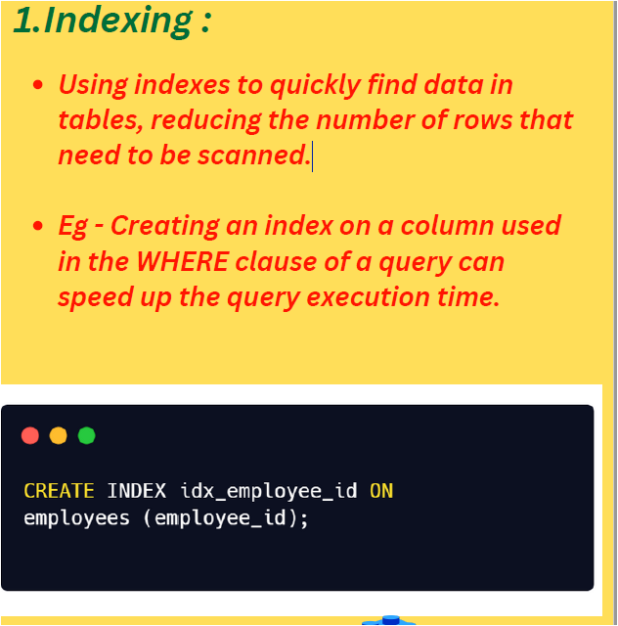
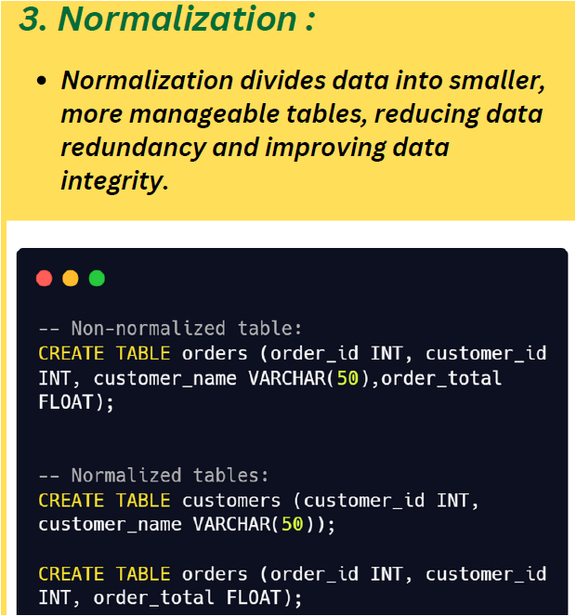
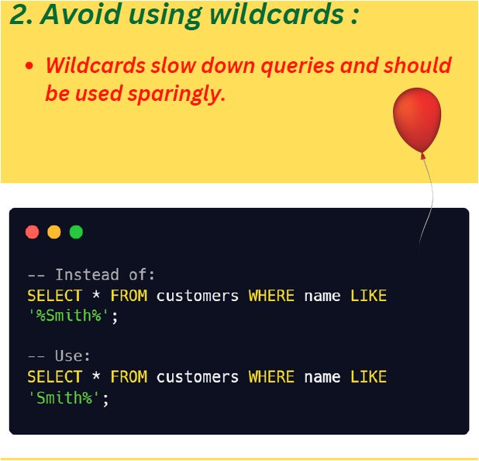
Optimization Techniques

Slide 9
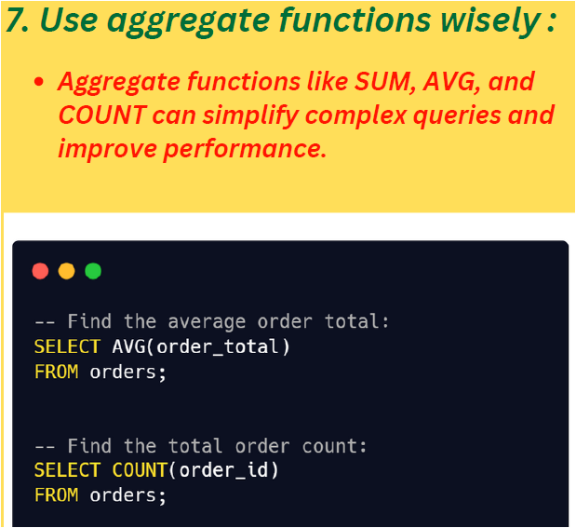
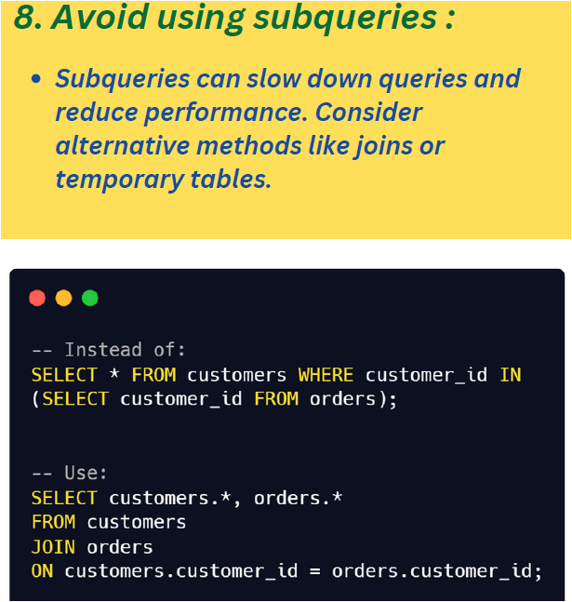
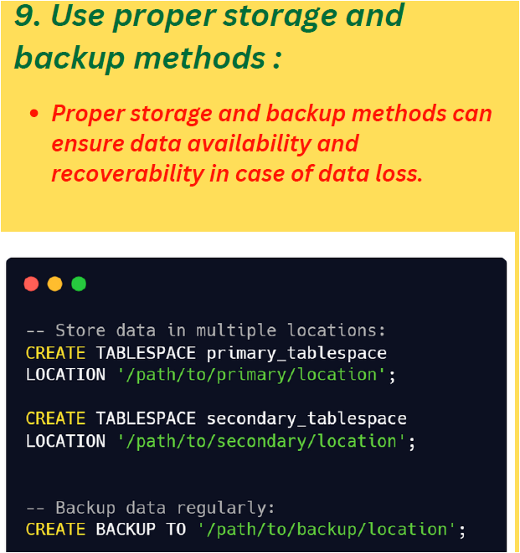
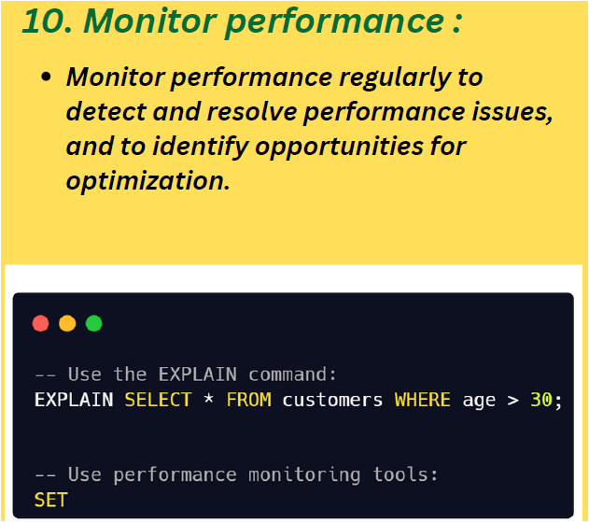
Optimization Techniques

Slide 10
Optimization Techniques

Slide 11
Monitoring and Performance Tuning Tasks
Topic | Task
Monitor SQL Server Components | Required steps to monitor any SQL Server component, such as Activity Monitor, Extended Events, and Dynamic Management Views and Functions, etc.
Performance Monitoring and Tuning Tools | Lists the monitoring and tuning tools available with SQL Server, such as Live Query Statistics, and the Database Engine Tuning Advisor.
Upgrading Databases by using the Query Tuning Assistant | Keep workload performance stability during the upgrade to newer database compatibility level.
Monitoring Performance by Using the Query Store | Use Query Store to automatically capture a history of queries, plans, and runtime statistics, and retain these for your review.
Establish a Performance Baseline | How to establish a performance baseline.
Isolate Performance Problems | Isolate database performance problems.
Identify Bottlenecks | Monitor and track server performance to identify bottlenecks.
Use DMVs to Determine Usage Statistics and Performance of Views | Covers methodology and scripts used to get information about the performance of queries.
Server Performance and Activity Monitoring | Use SQL Server and Windows performance and activity monitoring tools.
Monitor Resource Usage | Using System Monitor (also known as perfmon) to measure the performance of SQL Server using performance counters.

